Slide 1
Important Python Libraries For Data Analysis Examples

Slide 2
'''Dataframe is a main object in Pandas. It is used to represent data with rows and columns'''
import pandas
us_wars_by_end = {'day': ['1/1/2017', '1/2/2007', '1/3/2017'],
'temperature': [32, 35, 28],
'windspeed': [6, 7 , 2],
'event': ['Rain', 'Sunny', 'Snow']}
df = pandas.DataFrame(us_wars_by_end)
print(df)
print(df.columns)
print(df.event)
day event temperature windspeed
0 1/1/2017 Rain 32 6
1 1/2/2007 Sunny 35 7
1/3/2017 Snow 28 2
Index(['day', 'event', 'temperature', 'windspeed'], dtype='object')
0 Rain
Sunny
Snow
Name: event, dtype: object

Slide 3
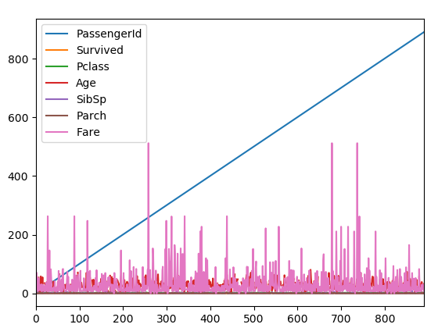
import numpy as np import matplotlib.pyplot as plt import pdb from pandas import *
data = read_csv('train.csv')
#print(data)
men = data[data.Sex == 'male'] women = data[data.Sex =='female'] proportion_women_survived = float(sum(women.Survived))/len(women)
proportion_men_survived = float(sum(men.Survived))/len(men) print(proportion_women_survived*100) print(data.groupby('Sex').Survived.mean())
#You can access a row with a cross-section (xs), in this case we choose
#the 0th row (replacing 0 with another index returns that row.
print(data.xs(0)) data.plot() plt.show()
#we get a summary of the data's structure
#<class 'pandas.core.frame.DataFrame'>
#One thing one might want to consider is whether the properties
#of the men's survival was different from the women's.
#So we can create separate data frames for men and women as

Slide 4
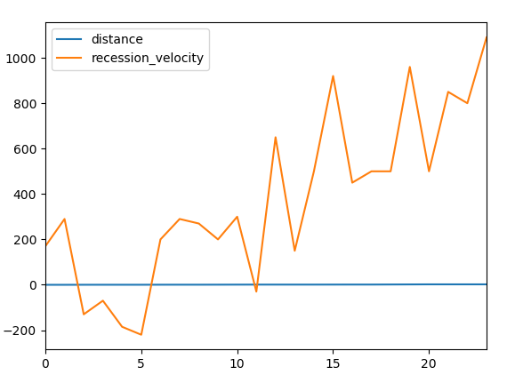
import pandas as pd
import matplotlib.pyplot as plt
data = pd.read_csv("hubble_data.csv")
print(data.head())
data.plot()
plt.show()
distance recession_velocity
0 0.032 170
1 0.034 290
2 0.214 -130
3 0.263 -70
4 0.275 -185

Slide 5
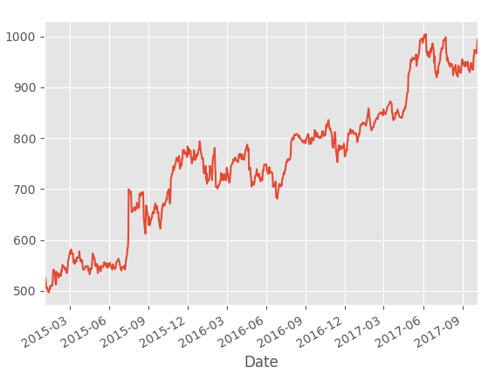
import datetime
import pandas_datareader.data as web
import matplotlib.pyplot as plt
from matplotlib import style
style.use('ggplot')
start = datetime.datetime(2015, 1, 1)
end = datetime.datetime(2018, 1, 1)
df = web.DataReader('GOOGL', 'yahoo', start, end)
print(df.head())
df['Adj Close'].plot()
plt.show()
Open High Low Close Adj Close \
Date
2015-01-02 532.599976 535.799988 527.880005 529.549988 529.549988
2015-01-05 527.150024 527.989990 517.750000 519.460022 519.460022
2015-01-06 520.500000 521.210022 505.549988 506.640015 506.640015
2015-01-07 510.950012 511.489990 503.649994 505.149994 505.149994
2015-01-08 501.510010 507.500000 495.019989 506.910004 506.910004
Volume
Date
2015-01-02 1324000
2015-01-05 2059100
2015-01-06 2722800
2015-01-07 2345900
2015-01-08 3652700

Slide 6
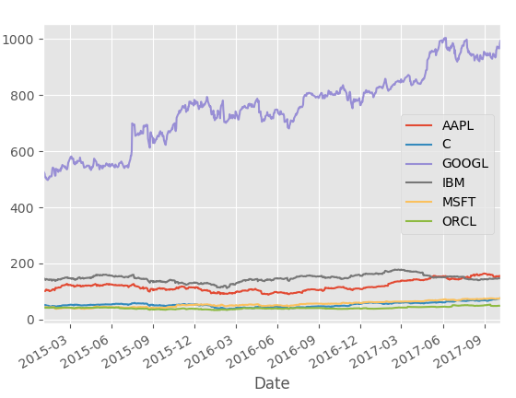
import datetime
import pandas_datareader.data as web
import matplotlib.pyplot as plt
from matplotlib import style
style.use('ggplot')
stocks = ['ORCL', 'IBM', 'C', 'GOOGL', 'MSFT', "AAPL"]
start = datetime.datetime(2015, 1, 1)
end = datetime.datetime(2018, 1, 1)
df = web.DataReader(stocks, 'yahoo', start, end)
print(df.head())
df['Adj Close'].plot()
plt.show()

